Slide 1
UNIFIED EXPERIENCE PLATFORM (UXP)
MARCH 2024

Slide 2

TODAY
Momentum gathers meaningful post-event metrics by unifying data from different sources.
Information is either not available or not shared in a timely manner.
This limits Momentums spend and agility when generating insights.

Slide 3
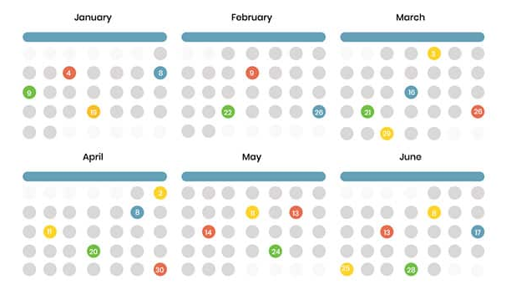









UNIFIED EXPERIENCE DATA ECOSYSTEM
Unified data aggregates data from disparate sources into a single view providing complete and accurate answers to critical questions.
Activation Schedule
Unified Experience Platform (UXP) and Input Procedure A front-end Input application and organization-wide process/system for collecting Activation Details and information: Activation Name, Activation Date, Activation Client, and Activation Location.
Unified Experience Data
Activation Insights
Field Management Portfolio-wide standardized system for managing event details, assets, and on-site wrap information. It includes a cloud/web-based tool accessible from anywhere for real-time updates and version control, eliminating the need for multiple spreadsheets.
Conversational Insights
Other systems: Walmart Hub, Splash, Placer data, Client owned systems
Cognitive Services

Slide 4
PROCESS
Momentum Data Discovery
Audit all data capture by the client team
What do we have?
What is the source?
What is the cadence?
What is captured manually by a field team?
Technical Discovery UED
Detailed requirements document
High-level solution architecture
API definitions
DB design
Front-end Mockup
Field Management: BrandScopic
Vendor Set Up, security & sign SOW
Design a deployment plan
Process and training material
Load test use case
Placer POC
Data extraction
API design calculating the number of calls
Document insights gathered
In progress
In progress
In progress
Today, we are here

Slide 5
DATA DISCOVERY

Slide 6
Current Workflow (BL OR XP)
Describe the current process from client requesting/approving programs to execution.
What tools or methods are currently used for tracking events
Pain points in the above methods

Slide 7
Stakeholder Identification and Roles
Who are the key stakeholders involved:
Scheduler
Event Details
BA or Staffing
XP
PM
Analytics

Slide 8
Event Data and Recapping
Where does the data currently come from, and are there any data entry challenges?
Are there specific data points or KPIs that are frequently overlooked but are important for reporting to client or internally?
What key KPIs or metrics do you regularly track for events for your clients? Which ones are for internal use and which ones are client requirements?
Breakout depending on program type?
Are there any specific insights you would like to gain from the UXP?

Slide 9
Integrations or additional systems used?
What are the existing tools and systems used in the client account the UXP should integrate with?
Ie. a reporting platform, client system, QR platform, Qualtrics, etc

Slide 10
Features and wish lists
What features do you think would streamline the event planning and tracking process for you?
Are there specific functionalities that you consider essential for your role managing events?
How would you prioritize these features based on importance?

Slide 11
THANK YOU

